Slide 1
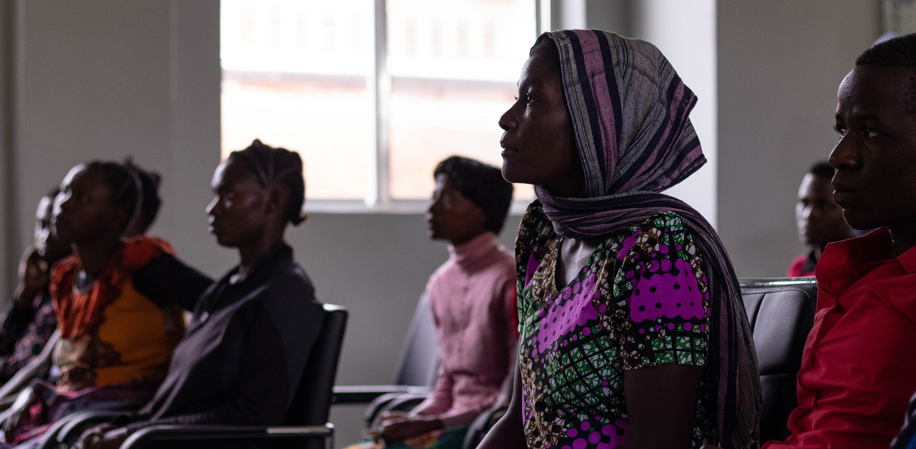
Human Centred Design
Co-Design of Storytelling & Documentation Tool

Slide 2
Agenda
Welcome & Introductions
Align on Goals
Review Findings from Discussions
Discussions & Ideation
Making a Prototyping Plan & Building a Tool
Testing Plan

Slide 3
Welcome
Name
Who You are in Your Community
What does Storytelling Mean to You?

Slide 4
Goals of Our Time Together
Review Findings
Identify Needs of Storytelling & Documentation Tool
Build Prototype
Create Test Plan – who to test with, type of feedback to collect
Test Prototype and Collect Feedback
Revise Prototype Based on Feedback
A Plan Moving Forward
What do we need to change / add?

Slide 5
Discussion Themes
Review Mural Board
Purpose of Stories for LISTEN
What Makes a Good Story
Challenges
Community Concerns
Documentation
Storytelling
What Could Work
What We Need

Slide 6
Discussion Themes
Review Mural Board
Purpose of Stories for LISTEN
What Makes a Good Story
Challenges
Community Concerns
Documentation
Storytelling

Slide 7
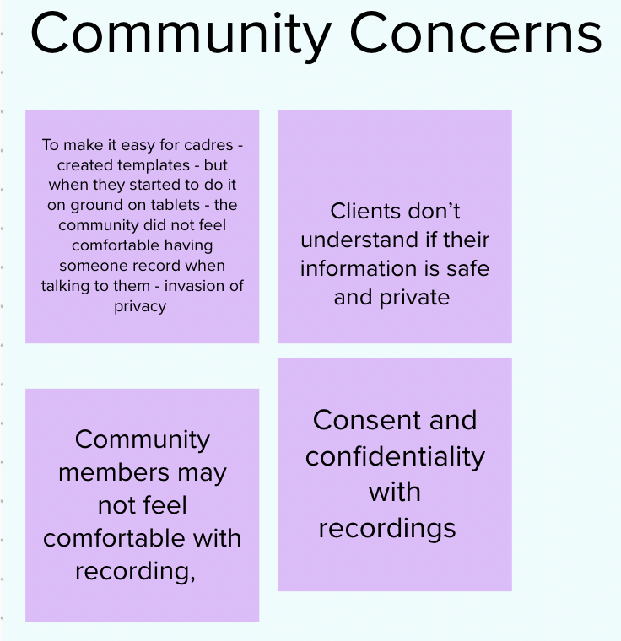
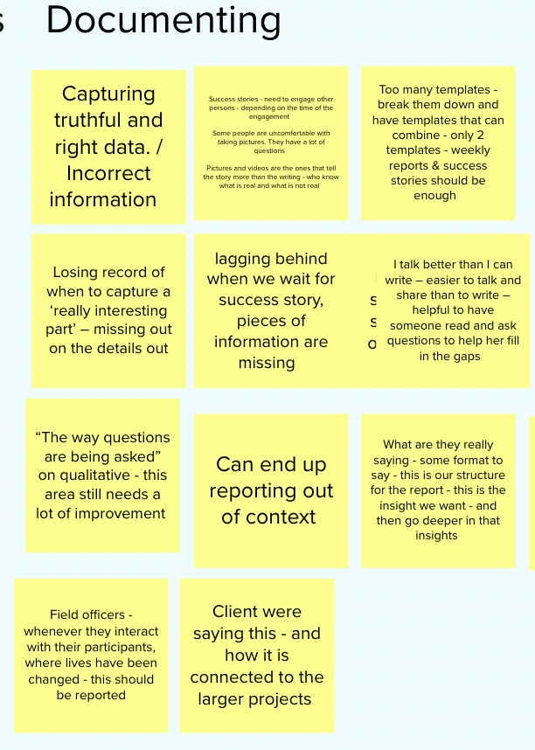
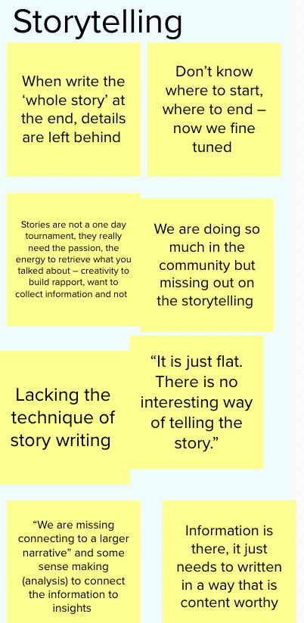
Discussion Themes - Challenges
Challenges

Slide 8
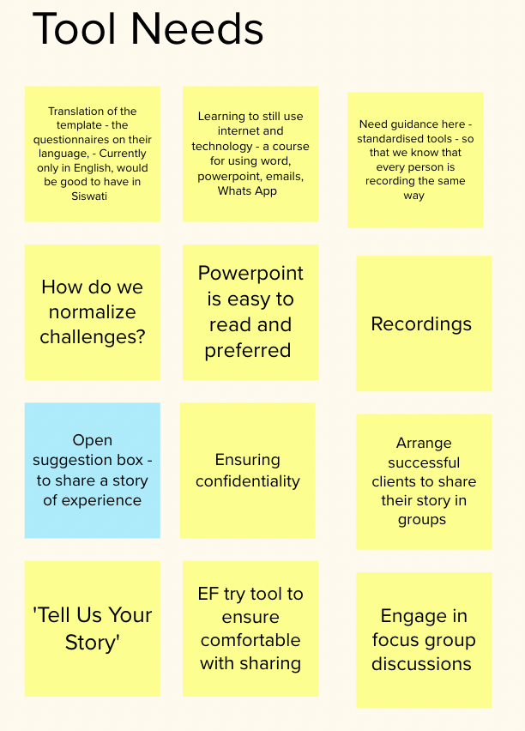
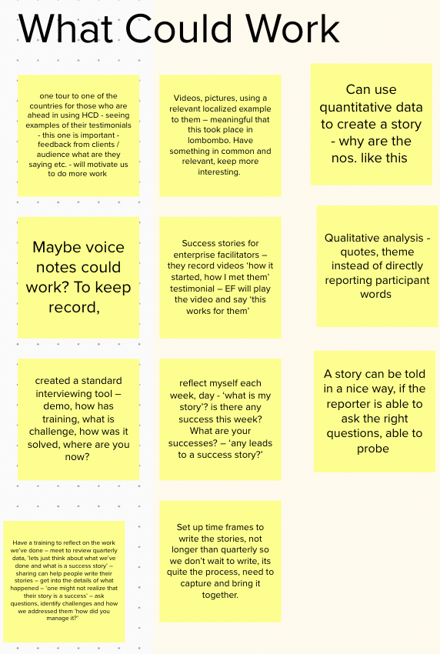
Discussion Themes
Review Mural Board
Purpose of Stories for LISTEN
What Makes a Good Story
Challenges
Community Concerns
Documentation
Storytelling

Slide 9
What Do We Need to Tell a Compelling Story?
Template to guide – to have at the back of our mind and to reference, not necessarily to ‘fill out’
Age, location, dates, key elements
When, why, what, who
Probes, questions to follow up
Examples
Photos, Audio, Videos
Pencils, notebooks
Server for backups
Guide for documenting
Dress, consent,
Basic skills of storywriting
Examples of success stories and learnings
How to capture more details
Capturing lessons learned
What could we differently, what are we learning from it? And what do we do moving forward?
Look at tide template for documenting for success stories – iterate on questions to better craft a story

Slide 10
Documenting Community Stories
Most Significant Change – An Option
“During the last month, in your opinion, what was the most significant change that took place in your community with LISTEN?”
Domains = Changes in:
The quality of people’s lives
The nature of people’s participation in development of activities
The sustainability of people’s and organizations activities
Anything else
Unemployment
Teenage pregnancy
Collect stories
A group reviews and chooses ‘most significant’ and identifies how they were chosen
Share feedback of

Slide 11
Documenting Success Stories
Current Approach
Engaging with Clients
Weekly Reports
Quarterly Success Story

Slide 12
Documenting Success Stories
Documenting & Storytelling Guide
Engaging with Clients
Weekly Reports
Revised Quarterly Success Story
‘Share Your Story’ Box
Cheat Sheet
Reminder
Monthly Success

Slide 13
Making a Prototyping Plan
What We Want to Test
Time – how long the tool takes to use with clients
Language – simple English, translated, straight forward language
Easy to Use
Effectiveness
Content
Attention Grabber / Intro
Story Scenarios / Icebreakers
Probes
Idea
Goals
Questions We Want to Answer
Feedback We Want to Collect

Slide 14
Co-Creating a Prototype
What is the purpose of this tool?
In what shape or form would this tool take?
What does this tool need to contain?
How frequently should this tool be used?
What else does this tool need?

Slide 15
Prototype: Collecting Success Stories Guide
Purpose: Reference to remind about important points when collecting success stories
Format: Half sheet of paper that can be added to notebook
Content: Identified areas of need
Share the purpose of the conversation
“Hello, my name is….”
Background to LISTEN
“Today I would like to learn more about your success story within LISTEN”
Seek consent to record, take photos and videos & share how these might be used
Address where the story goes and why it matters to share
“Sharing your story can help others in your community”
Build respect and trust / Build rapport
Use an icebreaker, scenarios, humor to engage
Remember to capture details
Who, Where, How, Why, What
Probe questions to learn more
“Can you tell me more about…..”
“How were you feeling…..”
Remember to bring your curiosity, empathy and creativity

Slide 16
Testing our Prototype
30 August, 2022
Who will we test with?
HIV Peer Educators will use to capture success stories with CPs
What do we want to learn from this group?
Time takes to use with clients
Useful
Usable
Assists in capturing detailed stories from clients
How will we seek out this feedback?
HIV Peer Educators will use as a guide with clients in the field to capture their stories
How will we capture that feedback?
Peer Educators will use and then we’ll have a shareout and prototype revision session

Slide 17
Collecting Success Stories Guide
Feedback Prompts
How long did it take you to have a conversation with this tool?
How long should we tell participants this will take?
Is the language simple enough?
What needs to be changed?
Do you feel like this tool helped you capture a detailed story?
If not, please explain why
What do you like about the tool?
What changes would you make to this tool?

Slide 18
Collecting Success Stories Guide
Feedback Summary
Background information –
Most powerful to let clients know what you’re looking for and why – v. helpful, creates a relaxed mood
‘We are going to learn from your story’
Challenges getting in consent, bc the conversation gets flowing - get consent at the end of introductions/backgrounds
Recordings can really share the emotions of the clients
Some people don’t want to share their names, some will say ‘my cousin’ or ‘my friend’
Confidentiality is very important
Time wasn’t enough for capturing everything – 10-15mins
Used an icebreaker of a similar story and that helped
“I heard you say, tell me more about….”
It’s not a one day tournament, you can go back and get more information
Creating safe space
Could inspire to share their story with others
Clients didn’t have the ‘how many?’ – may need to follow up with records
Found Impact: One of FC not able to attend health talks due to be in school, other FC members share the information they heard – the one sharing information is a Champion
Sometimes easier to show up and collect stories
The communities are seeing the impact for them

Slide 19
Collecting Success Stories Guide
Feedback Summary
More useful
Background information helped a lot,
Icebreakers it makes the client more comfortable to share information
Confidentiality is important and when this is shared, then they tend to share more
Sustainability – some of them know that LISTEN is in a time frame
V. helpful and as time goes by, can capture more success stories
Helped us a lot
Took a bit to get used to cheat sheet
‘The more we do this, the easier this will get’
‘He trusted me enough to write his own name’
‘They are not afraid to share their stories’
Time sometimes a struggle, say it takes 10mins

Slide 20
Field Visits
Observations - Stories to Share
HCD – applying with story capturing, capture the positive and negative of LISTEN
Take client to the clinic
Sustainability – community put up the posters, did work on their own
School selling soaps and polish – currently scaling up, learners are telling other, 2 students who were pregnant were brought back
FC – creating champions, sharing information, now spreading beyond the team to their own communities
Leadership – acknowledge and appreciate M., talked about the teenage pregnancy data and dialogues, they are the ones telling us that they’re addressing teenage pregnancy
Wellness center – they know LISTEN is time based, so this time they are doing for themselves
AGY – she mentioned girls club / health club, have whatsapp group with 200+ girls and they throw in questions, ‘we’re learning a lot from these groups’, meet sometimes, talk about HIV prevention
‘HCD has been the best approach’
LISTEN - ‘doing it for themselves’
Wellness clinic – improvements, more confident now with training on HIV care and treatment (HCD Facilitator pilot training project), initiating ART, standardized reporting tool

Slide 21
Field Visits
Youth Center
Not being utilized, now vandalized
Get electricity for security
Get center operational, use center for other purposes, CVs printed, host school events, debates, know your number campaigns, community center
Get people there
Concerns about who would be responsible
Encourage everyone to take responsibility for the center
5 communities discussions around how the center
Challenges with funding, pay for electricity, security
Working with ENYC
Building handed over and youth fund is responsible
Now designing a program within youth center

Slide 22
Collecting Success Stories Guide
Proposed Changes
Share the purpose of the conversation
“We would like to learn from your experience / story with LISTEN and we would like to take 10-15 minutes of your time.”
Seek consent to record, take photos & videos
Address confidentiality, where the story goes and why it matters to share - “Sharing your story can help others in your community”
Get an understanding of their knowledge about LISTEN
“Can you tell me what you know about LISTEN?”
Build respect and trust / Build rapport / Create a safe space
Use an icebreaker, scenarios, humor to engage
Remember to capture details
Who, Where, How, Why, What
Probe questions to learn more
“I heard you talk about [this], can you tell me more about…..”
“How were you feeling…..”
Capture lessons learned
Ask how we can improve
Remember to bring your curiosity, empathy and creativity
Remember this is not a one-day tournament, you can go back and get more information
Move consent and confidentiality to purpose of conversation
‘We are going to learn from your story’
Reminder to create Safe Space
It’s not a one day tournament, you can go back and get more information
Reminder may need to follow up on ‘how many’
Half sheet, portrait, 13-14pt, bold

Slide 23
Cheat Sheet
Share the purpose of the conversation
“We would like to learn from your experience / story with LISTEN and we would like to take 10-15 minutes of your time.”
Seek consent to record, take photos & videos
Address confidentiality, where the story goes and why it matters to share - “Sharing your story can help others in your community”
Get an understanding of their knowledge about LISTEN
“Can you tell me what you know about LISTEN?”
Build respect and trust / Build rapport / Create a safe space
Use an icebreaker, scenarios, humor to engage
Remember to capture details
Who, Where, How, Why, What
Probe questions to learn more
“I heard you talk about [this], can you tell me more about…..”
“How were you feeling…..”
Capture lessons learned
Ask how we can improve
Remember to bring your curiosity, empathy and creativity
Remember this is not a one-day tournament, you can go back and get more information
Half sheet, portrait, 13-14pt, bold

Slide 24
Documenting Success Stories
Documenting & Storytelling Guide
Engaging with Clients
Weekly Reports
Revised Quarterly Success Story
‘Share Your Story’ Box
Cheat Sheet
Reminder
Monthly Success

Slide 25
Future Prototypes
Share Your Story Box
Will create and set up in an area with youth
Get a box, paper, pens and instruction wording
Possibility to have a whatsapp number for youth to submit virtually
Revised Quarterly Success Story Template
Co-create template – remove boxes and use prompts for what to include in the story, remove target audience, move up request for photo
Use with next quarter stories and collect feedback on ease of use and output of stories collected
Revise as needed
Reminders 1 Week before Quarterly Stories Due
Sent out to Peer Educators
Monthly Success Stories
Use Quarterly Success Story Template
Collect feedback on usefulness

Slide 26
Documentation & Storytelling Guide
Topics
Normalize sharing with each other more frequently from another chiefdom
Daily sharing what stood out to you, quick call, audio clip, etc
Consent and sharing why you want to share a client’s story and how it will be used
How to identify a success story
Asking CPs to identify their success stories within LISTEN
Their learnings, changes in behaviors, insights, lessons learned
Documentation with photos, audio, videos, other methods
Guide when documenting: how to dress, using a notebook, etc
Use language client most comfortable with
Collect stories that the CP tells themselves
Prompts for key elements
Storytelling
Painting a picture for the next person
Bringing in 5 senses, emotions, as much detail as possible, suspense, what led to what, maintain interest, make someone understand what was going on
Communicate impact, share the process
Use quotes, photos, video clips
Answer the ‘So what?’ why LISTEN is different
Capture stories that demonstrate sustanability
Use various/mixed methods to tell story
Everyone is a storyteller – tips to get started, tell someone first in your own words
Pros and Cons of methods of collecting stories
Review stories with communities
Go back to the client who’s story you want to share to get more details and their input on the story before submitting
Share examples of powerful stories and why they work

Slide 27
Documentation & Storytelling Guide
Storytelling
Set the context – what usually happens,
What happened this time
Why is that different / meaningful?
Learning from a challenge/failure
Change in mindset
Other types of change (change in how services are offered, in how we interact with clients, etc)
You or a client discovered something new
New relationships
Communities taking action on their own
Capture the stumbles along the way that led to success - let
What is something you will never forget?
Where have you seen a shift in perspective or mindset with clients, communities, stakeholders, yourself?

Slide 28
Potential Story Frames
Community Leaders
Impact of mobile clinics
Describe challenges of accessing screening – barriers with distance and time required, even lack of seeking out preventative services because ‘not sick’
Introduction of mobile clinics
Quote about impact
Data about connecting clients with positive results to clinic
Teachers
Previously produced soap but did not work due to challenges with lack of receipt books, pot
LISTEN purchased receipt book, pot, support with EF, snacks for student participants
Students engaged, making floor polish and soap
Financial skills with students
FC
Even those who miss health talks due to being in school hear about it from other members of the team -> extended reach of health talks
Clinic Sister
“LISTEN doesn’t just impose things on us”
“It was a different story”
“It is working wonders”
”It is one of the best”
Set the context of what usual funding looks like – strategy given to clinic
Clinic developed strategies around teenage mothers
Early morning education series

Slide 29
Impactful Story
Eswatini Case Study: Teenage Pregnancy Dialogues
The Luyengweni chiefdom was provided with an overview of relevant data from health facilities in its catchment area, resulting in the identification of high rates of teenage pregnancy as a priority area of concern for the chiefdom. The community chiefdom leadership then collaborated with health providers and with support from the MOH LISTEN team, conducted community dialogues for over 175 community members. Of these 35 (20%) were adolescent girls 10-19 years, others engaged included male partners, parents/caregivers and community leadership.
Risk factors identified during the dialogues included bus conductors who target students using public transportation, girls from child-headed homes, girls in lower secondary school as males believed they were virgins and targeted them, low self-esteem, peer pressure, bullying, poverty, no relationship with a caregiver, early sexual debut, belief that sex will keep the partner, gender-based violence (GBV), and lack of knowledge of available sexual and reproductive health (SRH) services.
Potential solutions to preventing teenage pregnancies as identified by the community included:
Improve relationship with the girl child by dedicating time to bond and share advise
Provide for AGYW basic needs, toiletries, and sanitary pads, which are usually expensive and
inaccessible
Consistently keep track of school performance
Raising knowledge and awareness of gender and HIV, developing critical life skills, educate parents and
caregivers on risks of early sexual debut, unprotected sex and the available services to prevent
unwanted pregnancies and how to engage AGYW
Identifying children at risk of abuse and ensuring that they receive guidance and counselling, and
medical attention where necessary
Strengthening relationships between schools and communities to promote engagement in, and
ownership of, children’s education and support youth
Community programs to prioritize youth welfare
Bring back cultural practices that instill values e.g., reed dance-targets virgins/adolescents, lusekwane-
target Adolescent and young men without children
Through ongoing application of the HCD process, the chiefdom leadership engaged with representatives from three (3) schools in the community to creatively solve the complex problem of teenage pregnancies. Through a collaborative process, it was determined that:
- The schools will conduct weekly educational sessions on various topics such as HIV prevention, SRH, and self-esteem. Collaborators and potential resource persons for the sessions were identified. The first of these sessions was conducted by Usuthu Mission Primary School and Mhlabubovu Primary School working with the local clinic, school health program and police to provide 595 girls and 457 boys with information on self-esteem, menstrual health, and GBV.
- The schools will initiate life-skills projects such as making soap, fabric softeners and rearing broiler chickens, and offer training on entrepreneurship, financial literacy, and saving. Part of the proceeds will be used to buy school shoes, uniforms and toiletries for the AGYWs.
- Target classes were defined as grades 5-7

Slide 30
Next Steps
Next version of Cheat Sheet
Documenting & Storytelling Guide – FM initial draft
With examples – FM & Sethu
Revised ’Success Story Template’ - Sethu
Pilot ‘Share Your Story’ Box – Peer Educators
Write stories – Peer Educators & LISTEN team
Review stories and provide feedback – FM
Expanded team utilizing templates for storytelling -

